Slide 1
COVID IMPACT
Financial Analysis
Fairfield Township
By Julie Vonderhaar
June 2020

Slide 2
Current Financial Situation (at 50% of Fiscal Year)
General Fund Balance of $6,742,529
  Encumbrance of $252,132
  City of Hamilton payment of $225,000 plus for Round About Project
  YTD 78% of appropriated revenues received
Gasoline Tax Balance of $476,307
  Encumbrance of $46,624
  Additional $.10 passed into law has assisted with income shift/loss from 2019 to 2020
  YTD 65% of appropriated revenues received
JEDD Fund Balance of $1,320,286
  Encumbrance of $109,035
  Jan, Feb, and March at 39% for appropriated revenues received

Slide 3
Current Financial Situation (at 50% of Fiscal Year) Continued…
TIF - $3,694,996
  Encumbrance of $1,404,149.38
  YTD 51% of appropriated revenues received
  Income expected to increase with the addition of Storypoint and new TIF on Seward
Safety Service - $3,084,428
  Encumbrance of $8,553.29
  YTD 50.49% of appropriated revenues received
Cash balance - $18,012,970
  Encumbrance of $2,924,960
  YTD 54.6% of appropriated revenues received

Slide 4
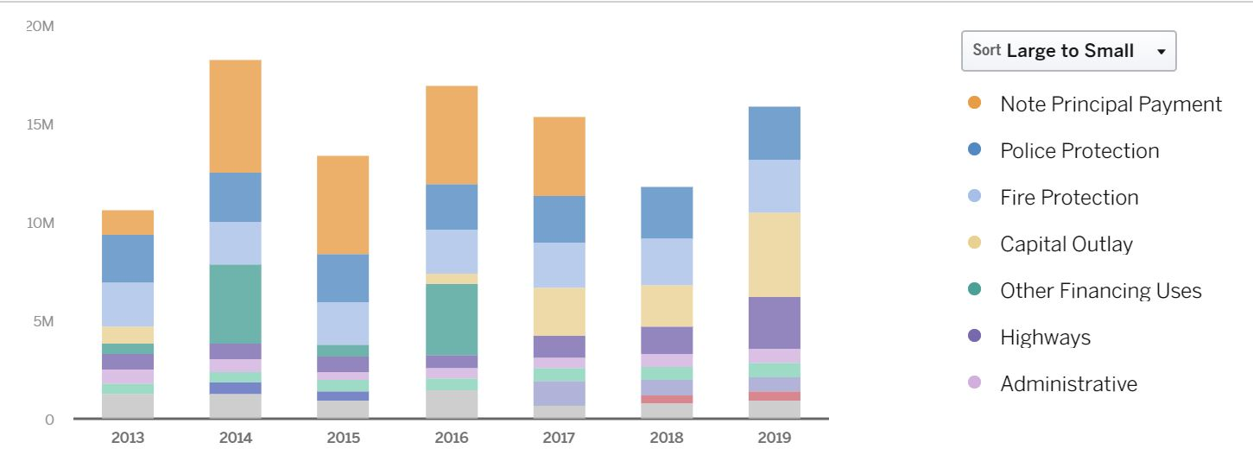
Expenses By Category from 2013-2019
2014-2017 $5 million Note Associated with a proposed Fire Station Build
Note was refunded
Revenues were greater than expenses in 2013, 2014, 2015, 2016,& 2018
2019 expenses were greater than revenues due to cash being used to fund the Fire Station Build

Slide 5
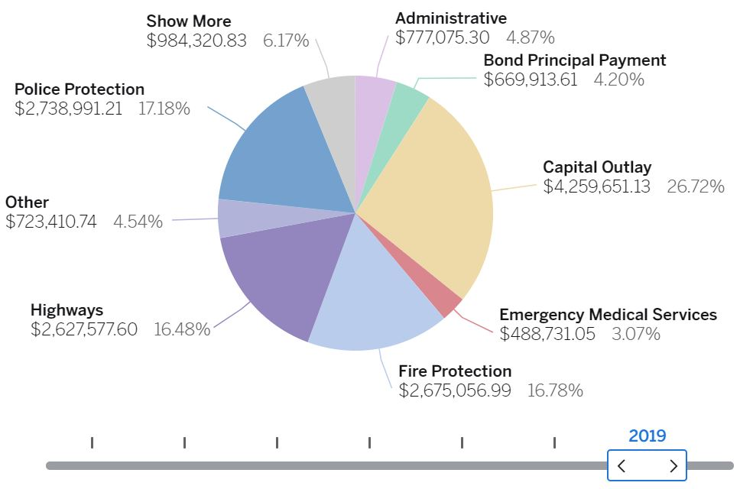
2019 EXPENSE BY CATEGORY
Capital Outlay was a large part of expenses
Cash used to pay for a new Fire Station
Cash used to pay for the Gilmore Road Round About

Slide 6
Largest Expense Every Year for Fairfield Township
Safety services and public works remain the bulk of the budget for Fairfield township
85% + of the budget in police and fire is used for salaries
These services are the backbone of the community
Over time costs rise and levy money does not stretch as far
Fairfield township continues to grow and improve while controlling costs

Slide 7
The greatest economic impact of COVID has included three main areas:
Local Government fund
Gasoline Tax
JEDD Fund

Slide 8
Local Government Fund
Revenue the state shares with townships
2019 Collected $375,000
2020 YTD $90,906 (received Monthly)
Loss of $284,000 if LGF is cut due to state losses

Slide 9
Gasoline Tax
Tax increased by $.10 a gallon late last year
2019 Collected $ 229,720
2020 YTD $108,710.40
JAN-APR 2019 = $55,050
JAN-APR 2020 = $108,711
6% loss in April
Estimated loss of 30% = $97,200
Due to tax increase township will see increased revenue in 2020 regardless of covid loss

Slide 10
JEDD Income
Held with City of hamilton
$270,000 collected in 2019 from Jan-mar
$700,000 collected entire year of 2019
$90,445 Jan-Mar 2020
Estimated loss of 20% from last year = $140,000

Slide 11
Grant Awards are allowing projects to be accomplished that may not have occurred because the Township would have needed to pay for 100% of costs
CDBG From Butler County
ODNR Heroes Park
MORE Safety Grant
Large and Small Storm Water
State Funding Veterans Memorial
Total Awarded Over $880,000
With $200,000 request outstanding to state for Veterans Memorial

Slide 12
Townships impacted less than Cities and Counties
Property taxes are stable which is our main income source
BWC Returned $69,833 (COVID REBATE)
OTARMA $500 FOR COVID SUPPLIES
HHS $15,871.33 in EMS for covid relief
Total losses based on calculations = $521,200 estimate which also depends on how long businesses stay shut down

Slide 13
In Conclusion:
Fairfield Township is in a stable financial condition with continuing clean audits and Aa2 Moodys Bond Rating.
COVID has resulted in costs associated with masks, gloves, and EMS supplies so that the Township is prepared.
COVID has resulted in costs associated with time spent by employees attending EMS and Health District meetings, delivering masks to nursing homes, and communicating to the public (less tangible cost).
CARES is a reimbursement program for many of the above COVID costs. If passed into law the Township plans to apply.
The Township employees have been and will continue to be completely transparent about all work accomplished and recommended. We are here to serve and work hard to make Fairfield Township an incredible place to live, work, and play!

